Slide 1
Design and Development of Automated International Financial Reporting Standards (IFRS) System

Slide 2
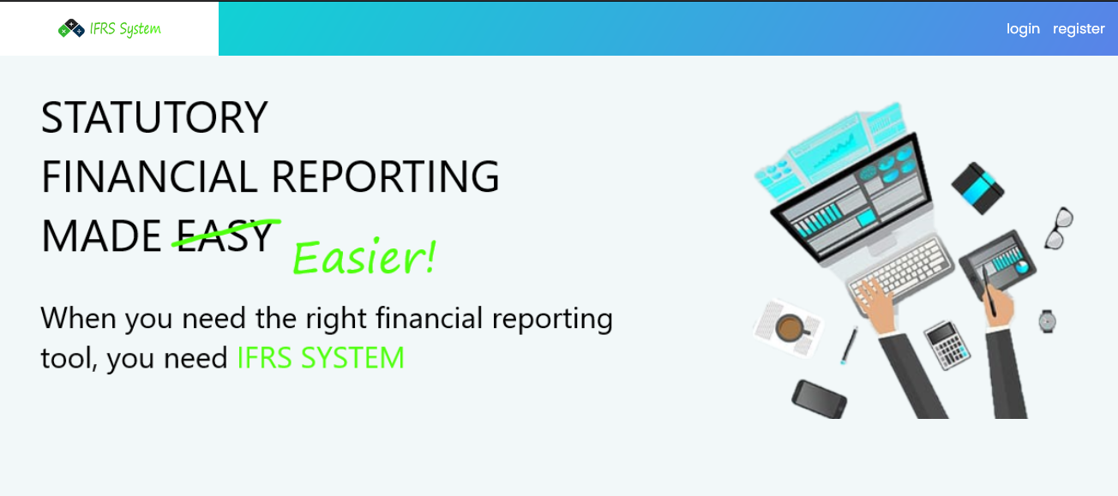
Automated IFRS System

Slide 3
International Financial Reporting Standards
IFRS is an accounting standards issued by the IFRS Foundation.
Providing a common accounting language to increase transparency in the presentation of financial information.
Currently required in more than 120 countries.
They specify how companies must maintain and report their accounts, and other events with financial impact.

Slide 4
IFRS Components
Statement Of Financial Position
Statement Of Profit Or Loss And Other Comprehensive Income
Statement Of Changes In Equity
Statement Of Cash Flows

Slide 5
Automated IFRS System
provide Financial reporting with Greater clarity and transparency.
Implement Main Components of IFRS Standards.
Statement Of Financial Position
Statement Of Profit Or Loss And Other Comprehensive Income
Statement Of Changes In Equity
Statement Of Cash Flows
provide a comparative report with the prior year .
Provide full User Management Features based on User Roles.

Slide 6
Challenges
Wide range of standards.
Lack of domain knowledge.
Lack of company’s professional accountants with regarding how to implement the IFRS standards.
Cost.
Time.

Slide 7
Limitations And future Work
The following are System Limitations :
Currently the System doesn't Support to Add Notes to the financial statements.
The Reports doesn’t consider Leases, Insurance Contracts and Some standards.
These tasks to be addressed in the future :
Make the system suggest possible decisions by incorporating machine learning algorithms.
Add Notes to the financial statements.
Add others IFRS standards those are not included in our system.

Slide 8
Thank You

